Slide 1

DevOps Fundamentals
Serhii Chernukha
TDF01-2

Slide 2
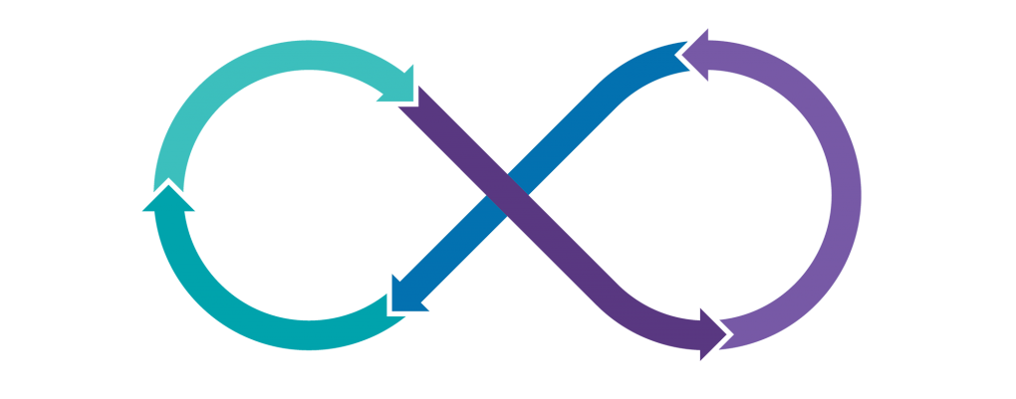

What is DevOps? Why it's important?; What is CI/CD? (Basic overview)

Slide 3

AGENDA
What is DevOps?
Why it’s important?
CI/CD:
- Continuous integration
- Continuous delivery
- Continuous deployment
- CI/CD Summary Principles
Levels of testing

Slide 4


INTRODUCTION
Set of skills
Softskills
Knowledge
success

Slide 5
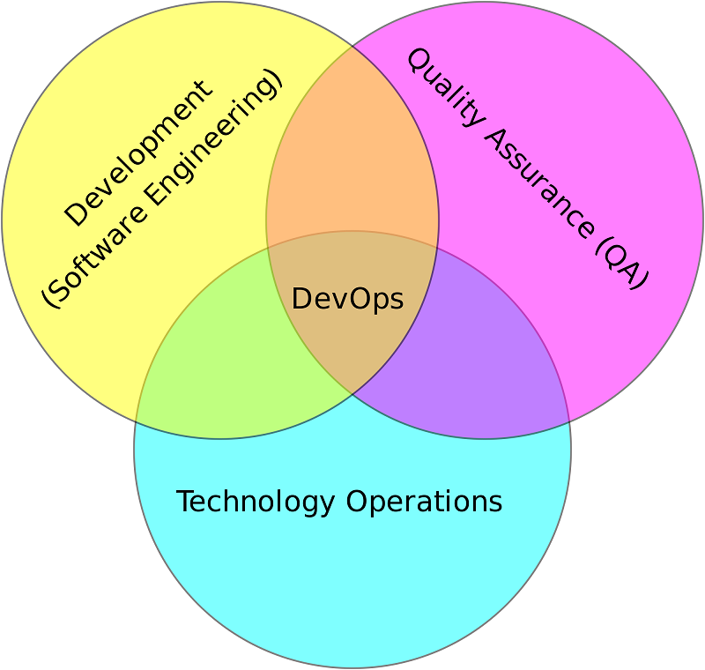
What is DevOps?

Slide 6
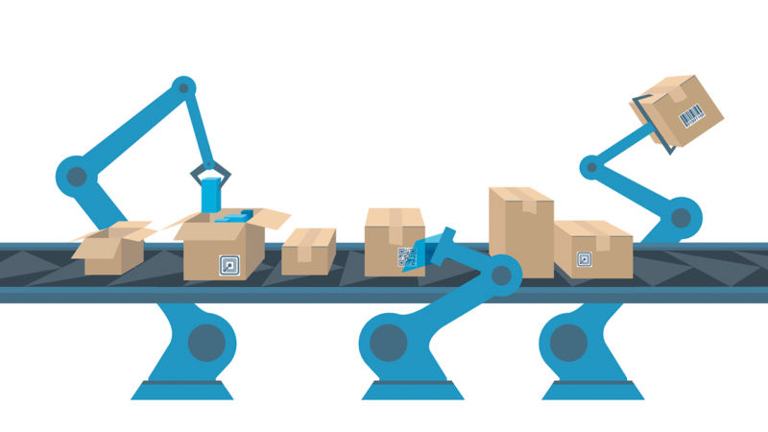


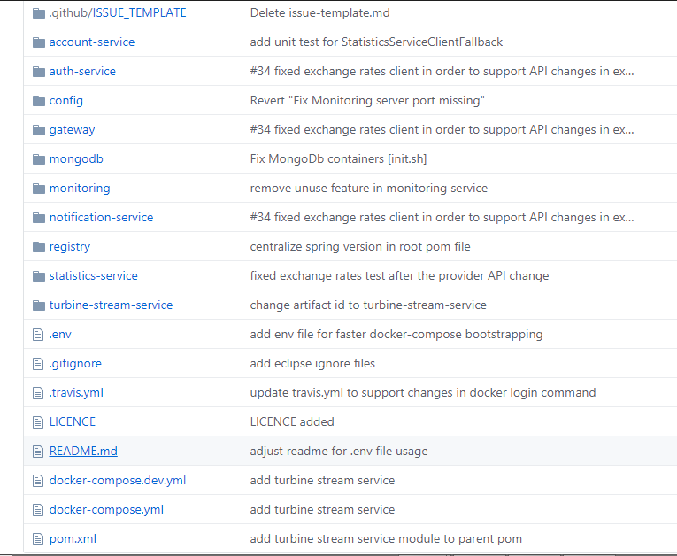
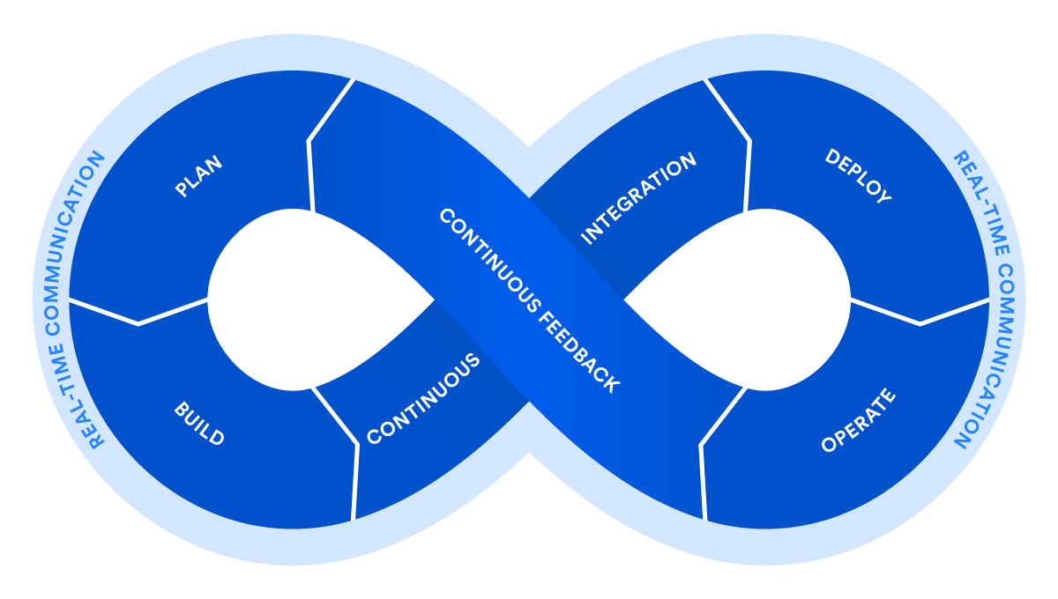
What is DevOps?
DevOps Methodology
Files
Application

Slide 7
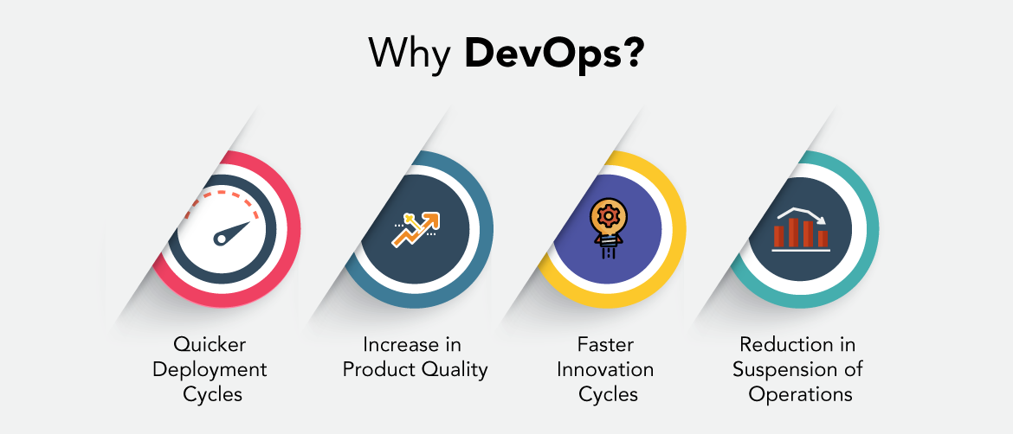
What it’s important?

Slide 8



CI/CD
Developer
Version Control System
Code integration
VCS
Build

Slide 9
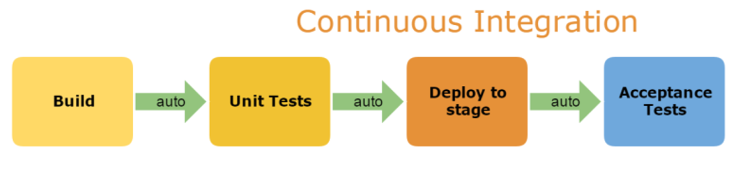
CI

Slide 10
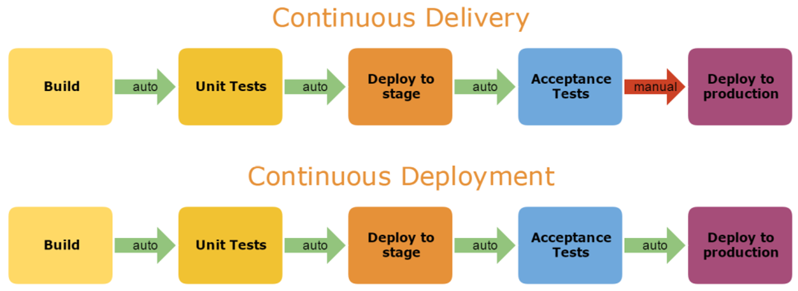
CD

Slide 11
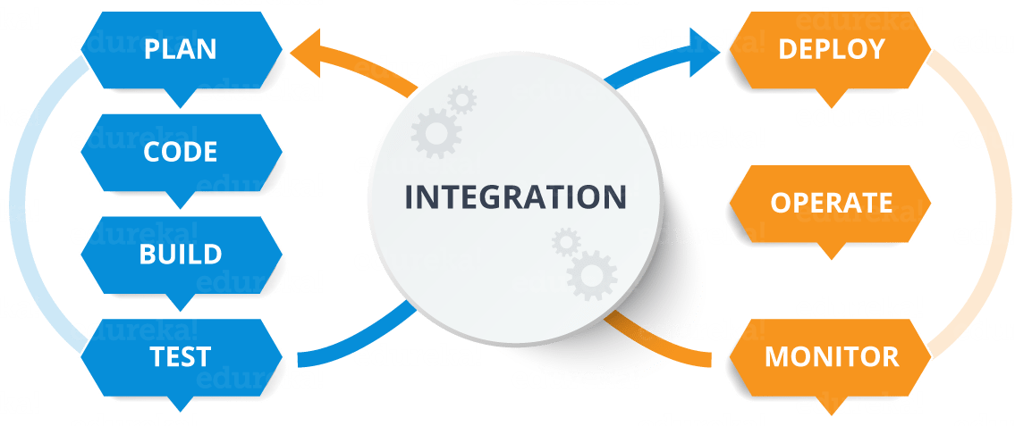
CI/CD
Continuous integration / Continuous deployment(delivery)
Pipeline

Slide 12
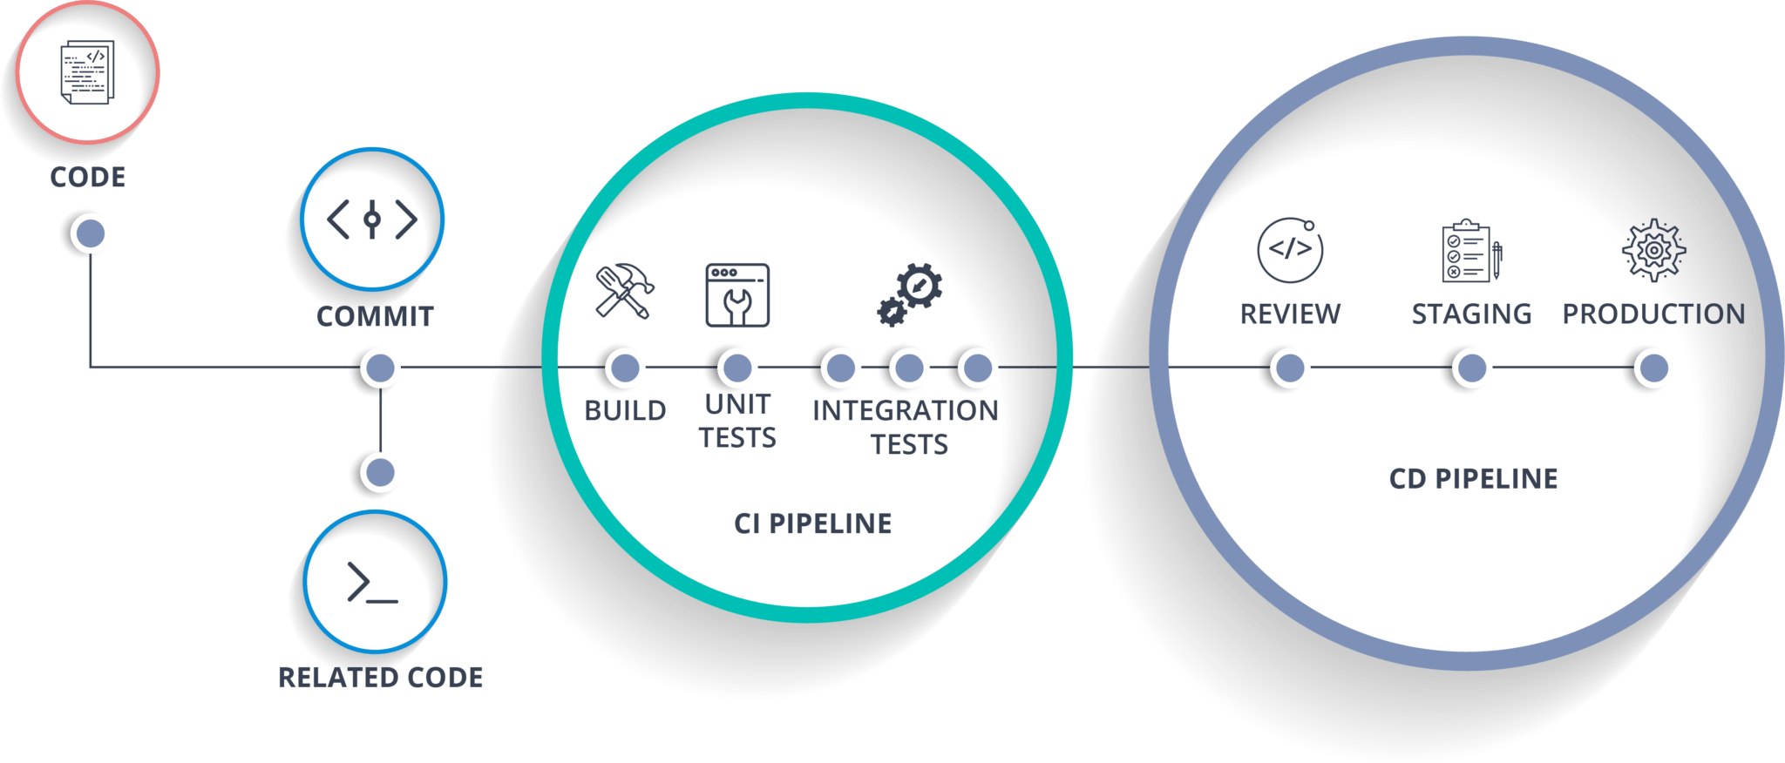
CI/CD

Slide 13
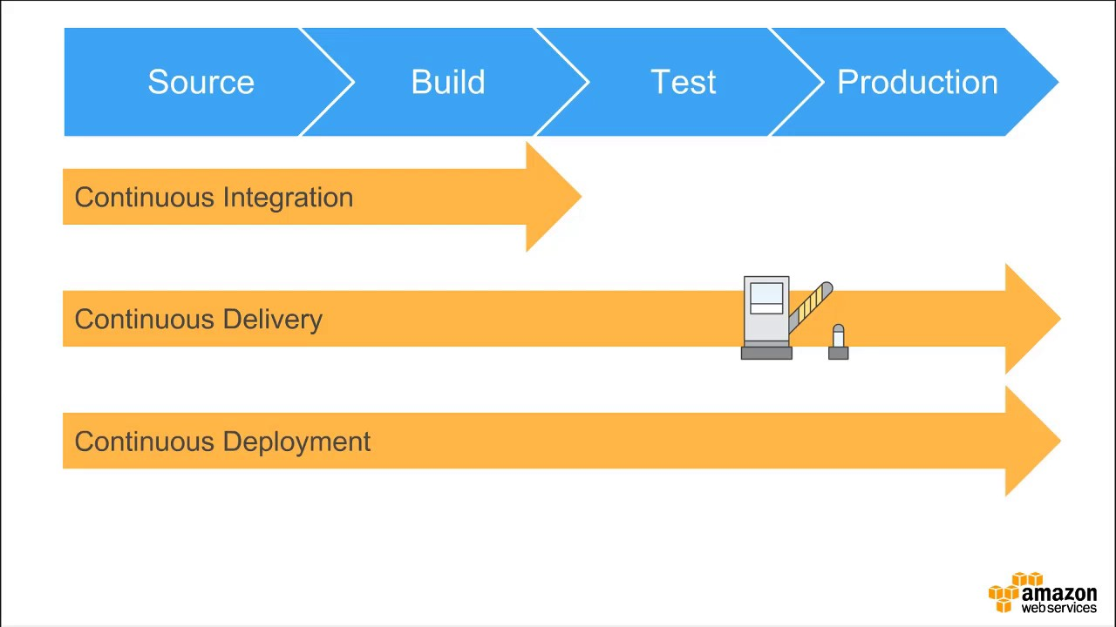
CI/CD
manually

Slide 14
CI/CD Summary Principles
Automate everything: build, test and deployment
Keep everything in a source code management system (use GitHub)
Keep absolutely everything in a source code management system
Use a CI tool that integrates tightly (webhooks) with your source code repository
Commit your code to the repository frequently
Don’t commit directly to a delivery branch; use a feature branch and PR workflow
Don’t ignore failing CI tests even on feature branches
Don’t merge broken code to a delivery branch; it must pass the CI system first
Deploy the same way to every environment
No-downtime deployments; stateless frontend, load balancer and sequential deployment
Automated feedback on the entire process
Use a container technology (Docker) if possible, as makes deployment simple
If the process is painful, you’re doing it wrong

Slide 15
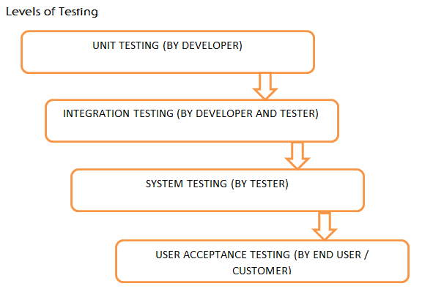
Levels of testing

Slide 16

Useful links:
DevOps: https://aws.amazon.com/devops/what-is-devops/
DevOps: https://devops.com/category/blogs/devops-practice/
CI/CD: https://www.atlassian.com/continuous-delivery/principles/continuous-integration-vs-delivery-vs-deployment
CI/CD: https://www.youtube.com/watch?v=QKKbi6dWHZE
CI/CD: https://www.docker.com/solutions/cicd
CI/CD: https://devops.com/how-to-implement-an-effective-ci-cd-pipeline/
Testing: https://www.guru99.com/levels-of-testing.html

Slide 17

Thank You

